Slide 2
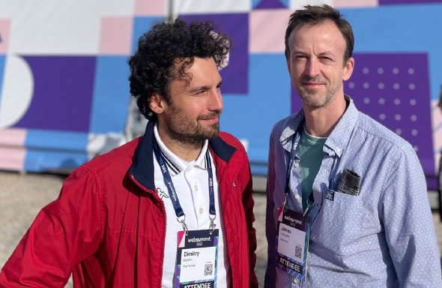
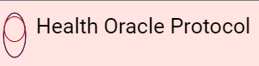
Sational
Sational
Germany
According World Health Organization 17.5% of the global adult population experiences infertility, with male infertility rates increasing by 76.9% from 1990 to 2019, highlighting the critical need for targeted male fertility solutions​.
Sational is more than just an app; it’s a lifeline for men struggling with fertility issues, an often overlooked and deeply personal challenge. We understand the heartache and the silent suffering of men who are desperate to start a family but find themselves grappling with infertility. Our app offers a private, engaging, and comprehensive solution to monitor and improve reproductive health through gamification and advanced digital technology. By providing secure data collection, real-time feedback, and personalized recommendations, Sational not only addresses a critical gap but does so with empathy and respect for the emotional journey of our users.
Sational is led by James, a health hacker, and Dimy, a technologist, both passionate about leveraging technology to address overlooked health needs. Our team combines expertise in healthcare innovation and cutting-edge technology to create engaging, secure, and impactful health solutions. We are driven by the profound need to support men facing the often stigmatized and deeply painful issue of infertility. The desperation and vulnerability of those with a genuine desire for children can lead them to take drastic measures, often at great personal and financial cost. This reality compels us to create a solution that respects and supports their journey, offering hope and tangible improvements in their health. Our collaboration with IKK classic will enable us to bring this much-needed support to a wider audience, ensuring that no one has to face this struggle alone or fall victim to schemes that exploit their desire for a family. We are committed to making a real, compassionate difference in the lives of those affected by male infertility.
2014
https://www.healthscience.network/
https://www.linkedin.com/search/results/all/?keywords=healthscience.network&sid=~P%3B

Slide 3
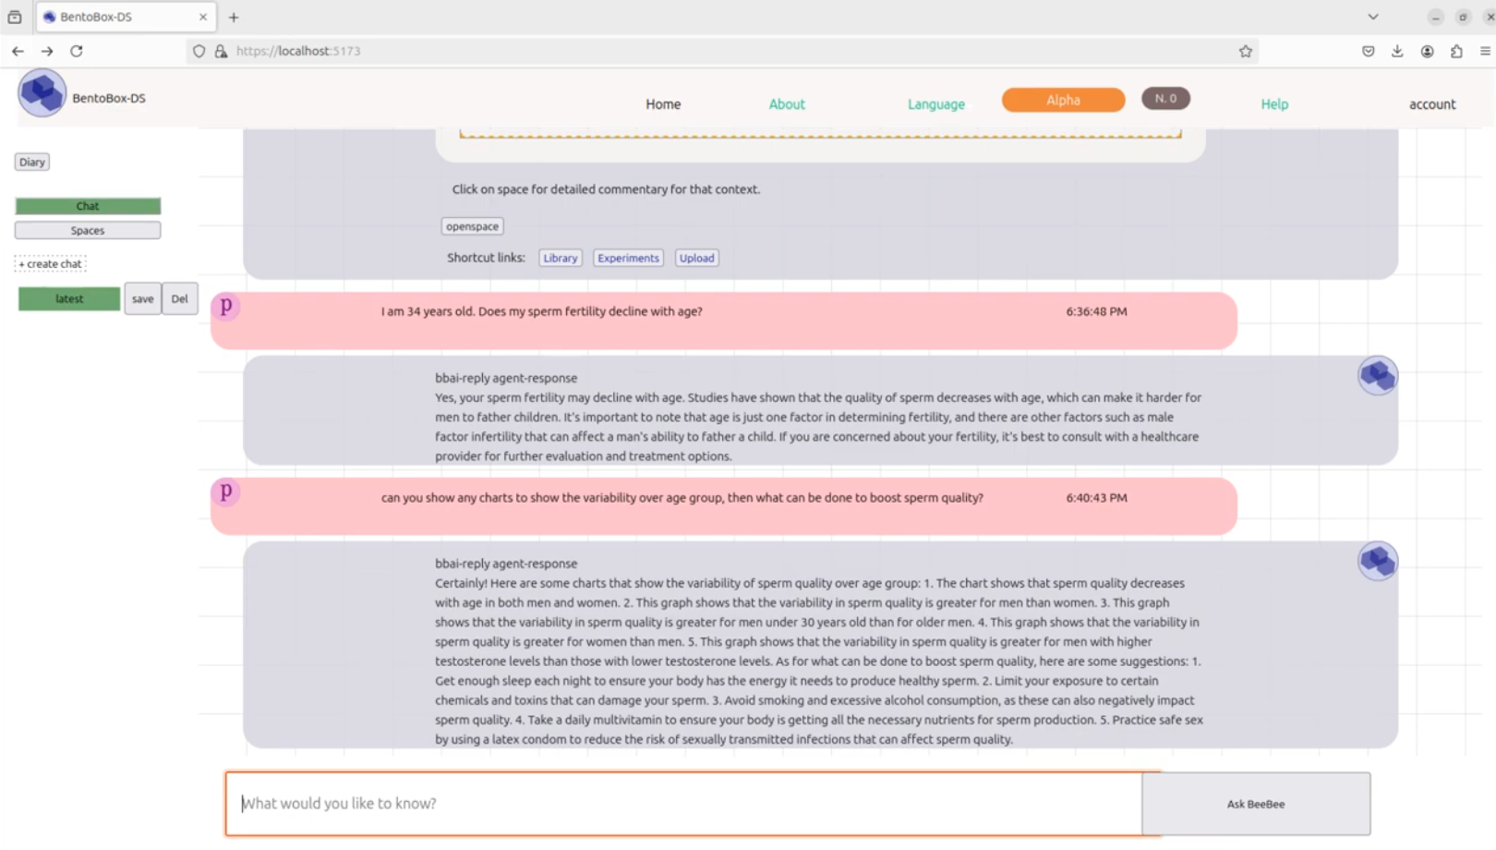
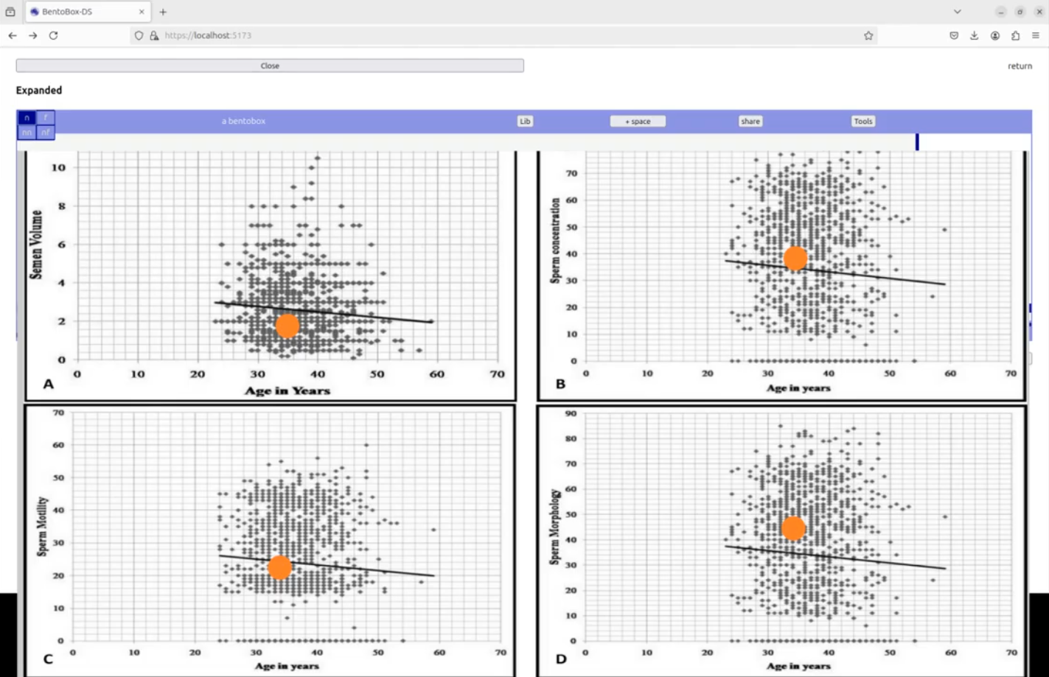
Male Fertility Health
Male infertility is a significant yet often overlooked health issue, contributing to nearly half of all infertility cases globally. Despite its prevalence, resources and support systems for men facing fertility challenges are sparse. This issue is compounded by social stigma and privacy concerns, deterring men from seeking help and discussing their fertility issues openly. The rising rates of male infertility, with a 76.9% increase from 1990 to 2019, highlight the urgent need for targeted interventions and accessible health solutions (source: World Health Organization).
Target Group
Men Facing Fertility Challenges
The primary target group for Sational includes men who are experiencing fertility issues or are interested in monitoring and improving their reproductive health. This group spans a wide age range, typically including men from their early 20s to late 40s. These individuals may be seeking to conceive naturally, improve their overall health metrics, or reduce their reliance on costly fertility treatments. The app is designed to cater to those who value privacy, desire actionable insights into their health, and are motivated by engaging, gamified health management tools.
Sational is a gamified health solution focused on improving male fertility through engaging and secure digital technology.
Key Features
Privacy and Security: Anonymous Data Collection: Ensures user privacy. Secure Sharing: Allows confidential sharing of health metrics.
Gamification Elements: Leaderboards: Motivates users by comparing their progress with others. Challenges and Rewards: Encourages healthy behaviors with badges and points.
Comprehensive Health Tracking: Semen Analysis: Logs sperm count, motility, and morphology. Lifestyle Tracking: Monitors diet, exercise, sleep, and stress.
Educational Resources: Information Hub: Offers articles, videos, and expert advice. Personalized Tips: Gives tailored ai driven health recommendations.

Slide 4
- Sational targets the often-overlooked issue of male fertility, providing a private, engaging, and comprehensive platform for men to monitor and improve their reproductive health.
- By using gamification and secure data collection, the app addresses privacy concerns and motivates men to engage in healthier behaviors, thus filling a significant gap in available resources for male reproductive health.
- Phase 1: Development and Testing Collaborate with IKK and healthcare professionals to develop and refine the app, conducting initial user testing.
- Phase 2: Launch and Promotion Integrate the app with IKK’s existing services, leveraging IKK’s network to reach potential users through targeted marketing campaigns.
- Phase 3: Scaling and Improvement Expand the app’s features based on user feedback and emerging research, while continuously promoting the app to increase user base and impact.
- Sational is at the prototype stage, with core features developed and initial user testing underway.
- We have conducted preliminary tests with a small user group, receiving positive feedback on usability and engagement.
- The approach leverages proven gamification strategies from successful health and wellness apps, ensuring a solid foundation for further development and implementation.

Slide 5
Phase 1: Development and Testing
Collaborate with IKK and healthcare professionals to finalize the app’s framework.
Conduct comprehensive user testing to refine features and ensure usability.
Phase 2: Launch and Promotion
Integrate Sational with IKK’s existing healthcare services.
Execute targeted marketing campaigns to reach the target audience.
Phase 3: Scaling and Improvement
Gather user feedback to make continuous enhancements.
Expand app features and services based on emerging health research and user needs.
Leverage IKK’s network to broaden the app’s reach and impact.
Motivation: Our goal is to help families to address the overlooked issue of male fertility health by providing an innovative, engaging, and private solution. Partnering with IKK enables us to leverage their expertise and network to achieve this impact.
Collaboration Models: We are interested in joint development and co-branding opportunities, integrating our app into IKK’s healthcare offerings, and collaborating on research and user engagement strategies.
Desired Outcomes: Improved male fertility health awareness, reduced financial burden of fertility treatments, and enhanced overall health outcomes for users through a scalable, impactful digital health solution.
https://bentobox-ds.gitbook.io/bentobox-ds-hop
Past Projects: Our team has previously developed health tech solutions focusing on building hospitals within VAMED Group.

Slide 6
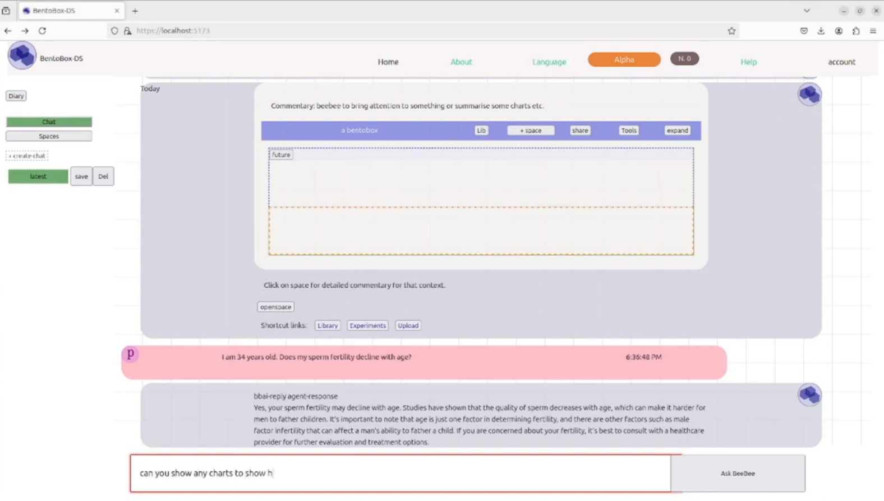
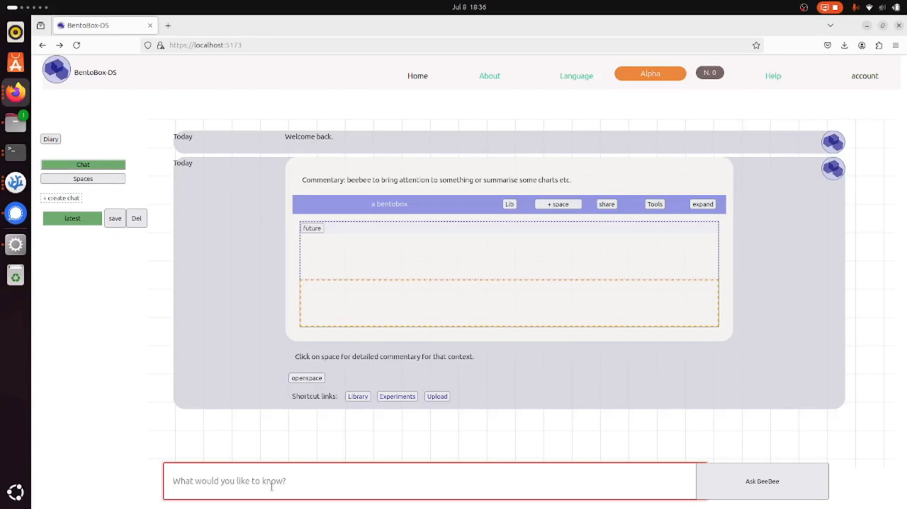
Video Description – User Interaction with Sational
1. User Onboarding:
- The user starts by creating an account and setting up their profile, which includes basic health information and goals.
2. Health Data Input:
- Users log their health metrics, including results from at-home sperm test kits, diet, exercise, sleep patterns, and stress levels. The input process is straightforward and secure, ensuring user privacy.
3. Dashboard Overview:
- The main dashboard provides a comprehensive overview of the user's health data, displaying key metrics like sperm count, motility, and morphology. It also tracks lifestyle factors such as diet and exercise.
4. Gamification Elements:
- The dashboard includes leaderboards where users can see how their health metrics compare with others anonymously. This competitive element motivates users to improve their health scores.
- Users can participate in challenges and earn rewards, such as badges and points, for achieving specific health goals.
5. Instant Feedback and Recommendations:
- The app provides real-time feedback on the logged data, helping users understand their results and offering personalized health recommendations.
- Educational resources are available, including articles, videos, and expert advice on improving male fertility and overall health.
6. Progress Tracking:
- Users can track their progress over time through visual graphs and reports, making it easy to see improvements and identify areas needing attention.
7. Secure Sharing:
- The app allows for secure peer-to-peer sharing of health metrics with healthcare providers, enabling users to get professional insights while maintaining confidentiality.

Slide 7
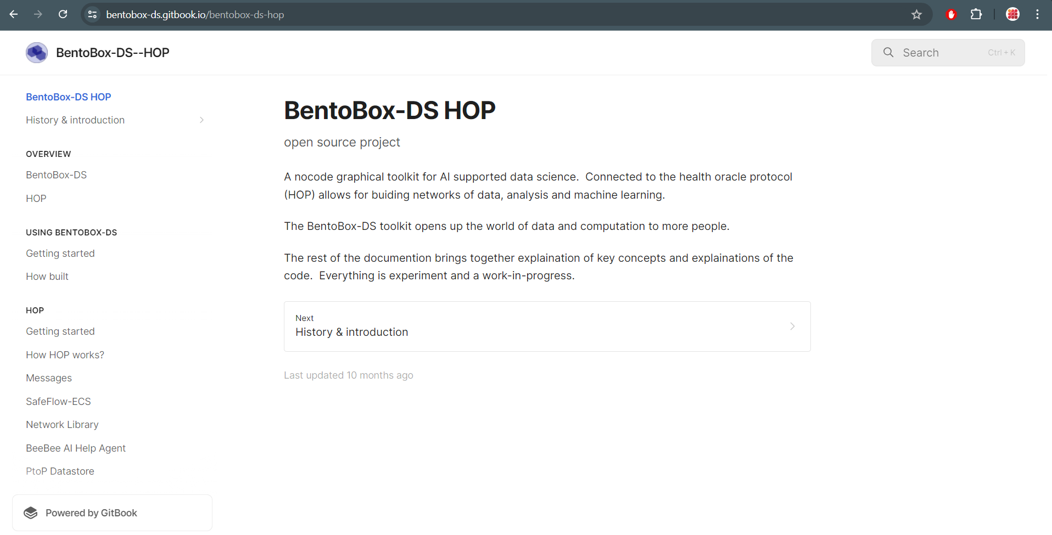
How Sational Works: Technical Background
Sational is a gamified health app designed to improve male fertility through secure, engaging, and comprehensive digital solutions. The app integrates advanced technologies to provide users with real-time feedback, personalized recommendations, and a private platform to track and enhance their reproductive health.
Key Components and Technologies
1. User Onboarding and Profile Management
2. Data Collection and Integration
3. Data Storage and Security
4. Gamification Engine
5. Real-Time Feedback and Recommendations
6. Educational Resources
7. User Interface (UI) and Experience (UX)
8. Monitoring and Continuous Improvement
https://bentobox-ds.gitbook.io/bentobox-ds-hop

